Slide 1
Impedance Spectroscopy
Kitty Harris and Josh Eslarboukh

Slide 2
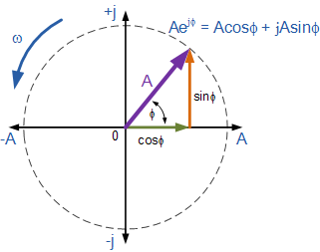
Phasor Notation
Phasors are essentially a shorthand for oscillating functions expressed as functions of their phase and magnitude
Name is portmanteau (“phase vector”)
Consolidates signal information, for example:
e(t)=√(2)Acos(ωt+ϕ)
Becomes A∠ϕ = A*e^(jω+ϕ) where j=√(−1)
Allows for use of complex impedance
Z = R + jX
Z = total complex impedance
R = resistor impedance, “resistance”
X = capacitor/inductor impedance, “reactance”
Complies with Kirchhoff's circuit laws and Ohm’s law of resistivity

Slide 3
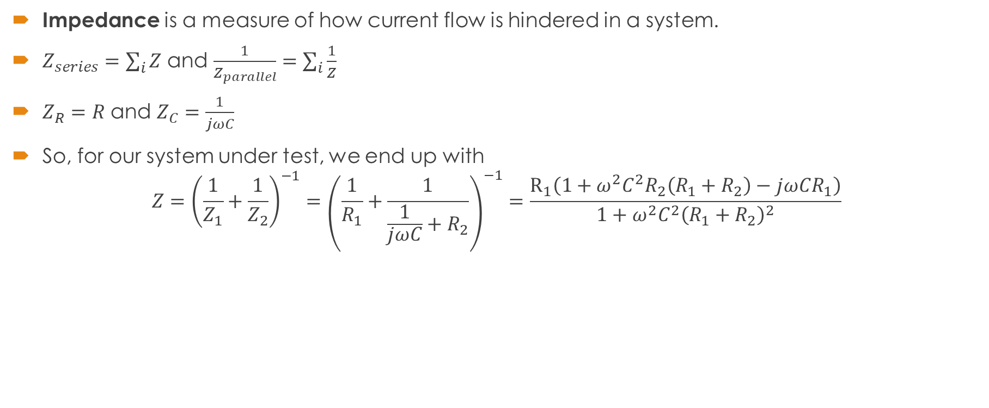
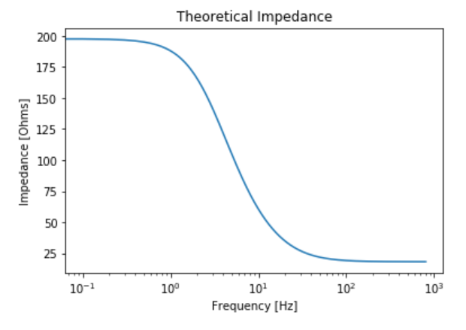
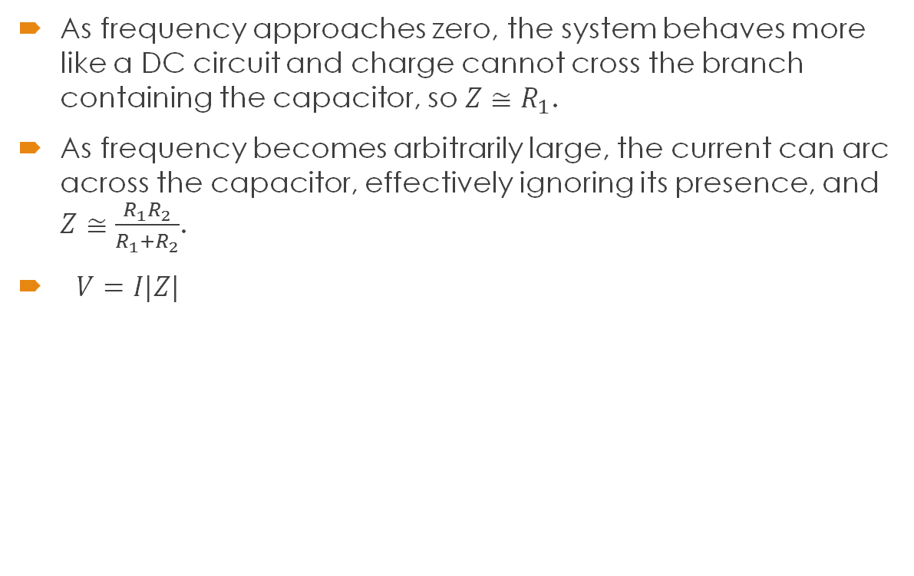
Frequency Dependence of Impedance

Slide 4
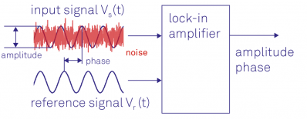
Lock-In Amplifier
Especially at low current, background noise conflicts with data
Need a way to remove unwanted signals
One solution: Lock-in Amplifier
Phase sensitive detection / demodulation
Synchronizes internal oscillator to external reference signal
Multiplies and integrates two signals (reference and input):
Asigsin(ωsigt+ϕsig)×Arefsin(ωreft+ϕref)
Output becomes:
0 for differing frequencies
Vout=(1/2)Vsig*Vref*cos(ϕ)
Result is isolation of signals with frequencies of interest, effectively reduces background noise

Slide 5
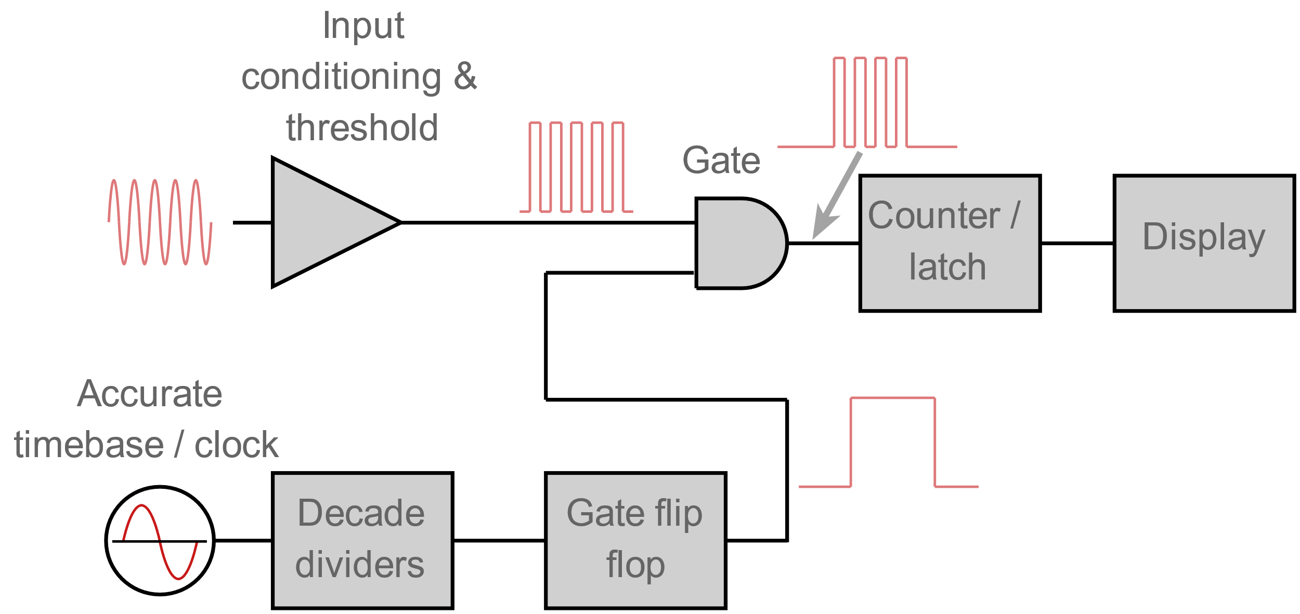
Frequency Meter
A digital frequency counter measures frequency by taking counts of a periodic function over a gate time.
Direct counting methods measure how many times the voltage (or other property being measured) passes a given threshold.
Reciprocal frequency counters measure the period of a cycle and take the inverse.
A clock produces a signal which is divided by the decade dividers into the appropriate gate time.
The “gate flip flop” receives this information and signals when the next set of counts should begin.
The latch holds the last value so that it can continue to be displayed while the counter is updating based on a new set of data.

Slide 6
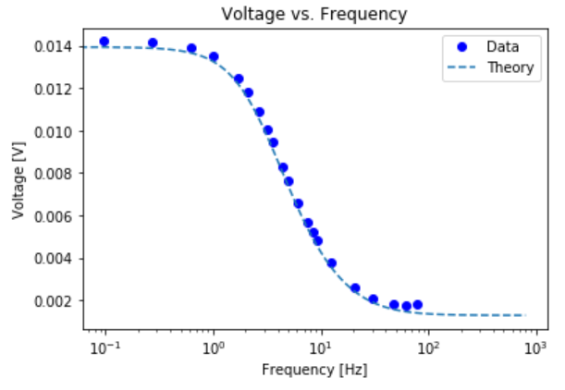
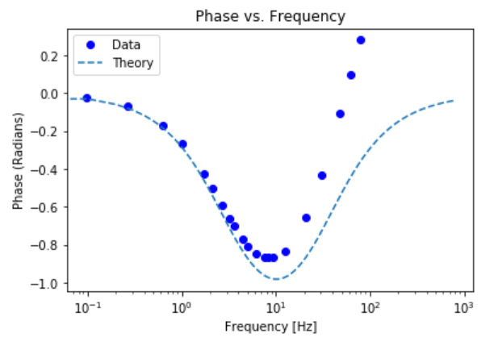
Prediction vs. Data
Voltage Data
We see an almost perfect correlation here, especially in the center.
Asymptotes match fairly well
Standard deviation: 8*10⁻⁸[V]
Phase Data
The left half of the plot appears to be roughly correct.
The dip occurs at the right point.
We have positive phase; this should be impossible with an ideal circuit of our type
Possible explanation: Something within the circuit is behaving as an inductor, producing a field opposing the current, causing the positive phase.
Standard deviation: 0.05 [radians]
[kHz]
[kHz]

Slide 7
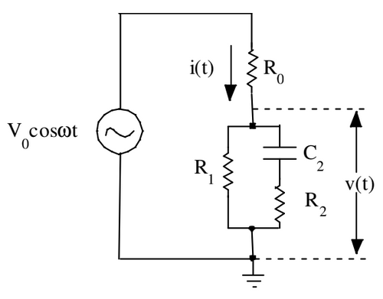
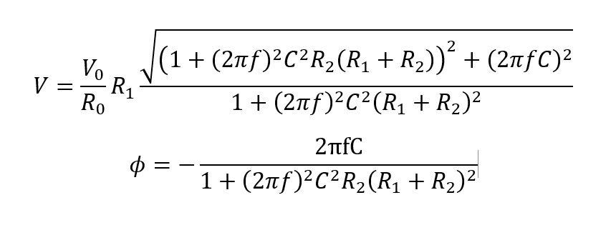
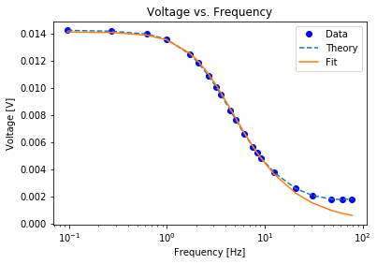
Curve Fitting
Assuming a circuit with the same arrangement but different component values, Python can be used to fit a curve and approximate unknown circuit values
SciPy.curve_fit() allows users to define a custom function with parameters to be optimized
Values from curve_fit
R0 = 6.82329841e+04 R1 = 1.36179032e+03 R2 = 1.00003488e+00 C = -2.20289657e-04
Covariance Matrix: [7.29720286e+21 1.45637188e+20 2.08120685e+14 2.35187976e+13] [1.45637188e+20 2.90661927e+18 4.15366154e+12 4.69386915e+11] [2.07711078e+14 4.14548663e+12 2.78138962e+07 6.67042843e+05] [2.35188426e+13 4.69387815e+11 6.68364286e+05 7.58012135e+04]
Fit is close until higher frequency limit
Possible background inductance affecting derivation for V(f) due to affect on total system impedance
[kHz]

Slide 8
References
https://www.instructables.com/id/Digital-Frequency-Counter/
https://www.electronics-notes.com/articles/test-methods/frequency-counter-timer/how-does-a-frequency-counter-work-operation.php

